Slide 1
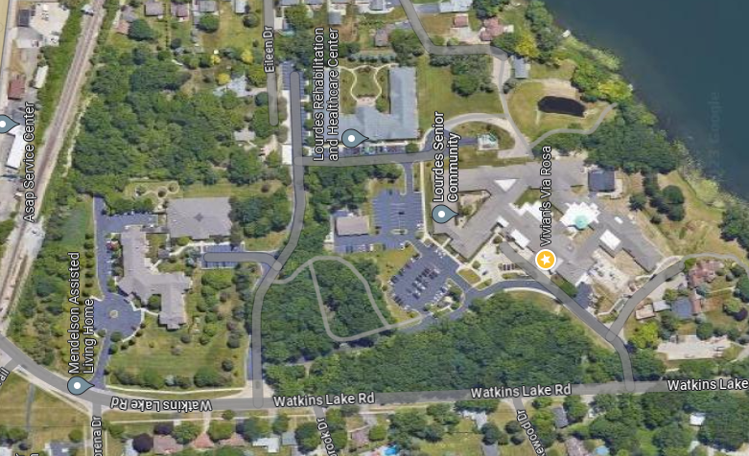
Lourdes Senior Community

